Slide 1
LVTGA Ryan White Part A CQM Meeting
September 24, 2024

Slide 2
Single Points of Contact (SPoC)
Golden Rainbow
AFAN
AHF
AHN
CCC
COMC
Dignity
Becky
Karina
Susana
Lorianna
Josefa
Clare
Wilma Anthony
Sandra
Yendi
Darnell
Impact Exchange
North Country
Nye County
CAN
SNHD
UMC
UNLV
Ronny Brennen
Lisa
Lacey
Carrie
Anita
Christine
Paty
The Center
Joseph Vanessa
Veronica Albert
Project Home

Slide 3
Quarter 3 CQM Meeting

Slide 4
Reason for Increased Strategic Meeting Frequency​
Our CQM teams were consistently reaching out for reminders about next steps and to make sure they were on the right track. It was evident that there was an information exchange gap. This led to uncertainty and the need to meet more often at multiple sites. ​

Slide 5
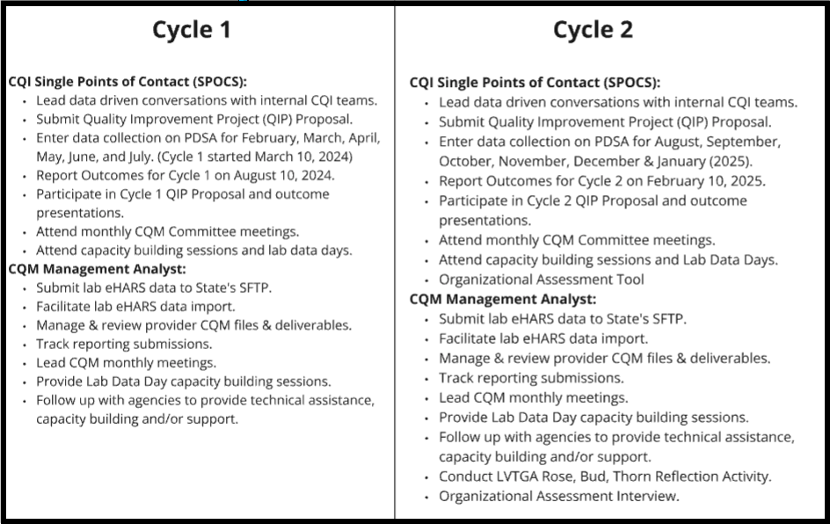

Slide 6
QIP Outcome Report Presentations

Slide 7
Cycle 1 Outcome Report Presentation Status Pending as of September 23, 2024

Slide 8
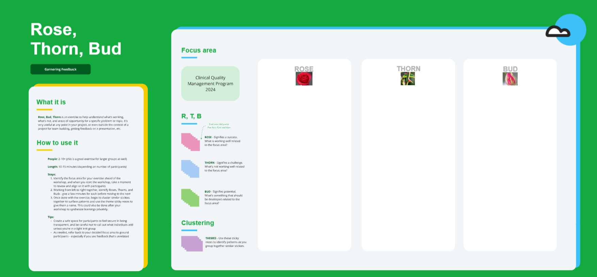

Slide 9
LVTGA Current Performance Measurement Report
Performance Measure | 2023 Baseline – 2024 Goal | 2024 |Q1 | 2024| Q2 | 2024| Q3
EIS Linkage to Care | 61.44% - 65% | 58.89% | 65.94% | 68.05%
MCM Viral Suppression | 79% - 83% | 68.43% | 68.68% | 64.44%
OAHS Viral Suppression | 89.30% - 92% | 83.58% | 83.51% | 80.42%
Receipt of Care | 90% | 27% | 27.24% | 25.63%
Retention in Care | 72.80% | 76.95% | 78.65% | 77.79%

Slide 10
Agency Enrollment Status Definitions
Active means a client is eligible and receiving services.
Inactive/Case Closed- is for when a client stops coming to your agency and after you have completed your agency’s outreach attempts to retain that client in care, or you are notified by the client that they no longer need your agency’s services.
Incarcerated – this option is most often used when your agency is notified that a client identifies as incarcerated. Some agencies treat this option differently depending on their funding and population needs. If you are unsure, check with your agencies policies and protocols.
Referred or Discharged – This should be selected when a client is referred to another provider, maybe to another Ryan White Agency to meet their needs or have been discharged from your agencies services because they have completed their program and no longer need your agencies services.
Relocated – is when a client has moved and is no longer receiving services from your agency, often when a client moves outside of your agency’s service area.
Removed – is for when a client has violated your agency’s rules or conduct requirements and has essentially been fired as a client with your agency.
“Mini-Mod” is only available for clients that are not RWPA eligible (EHE Applications). This will allow the user to update Demographics, Race/Ethnicity, Diagnosis, Labs, Services, Medications (Poverty, Insurance & Annual Screenings). This allows for the collection of data elements needed for RSR.

Slide 11
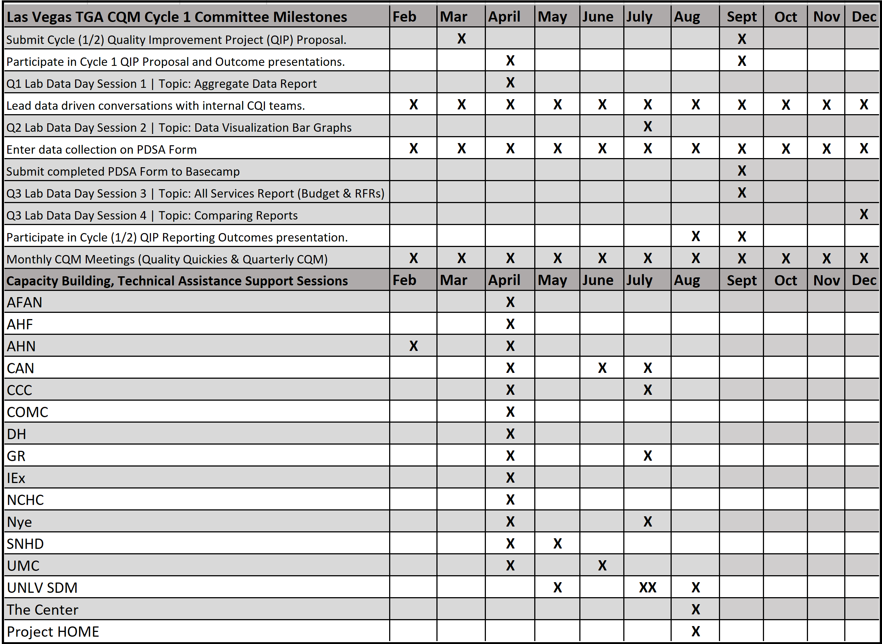

Slide 12
Upcoming Reminders
Miro – CQM SWOT Analysis
Q3 Capacity Building Sessions Upon Request
CQM Cycle 2 QIP Proposal Discussion
CQM Meeting - Tuesday, October 29, 2024
Organizational Assessment

Slide 13
Questions

