Slide 1


LVTGA Ryan White HIV/AIDS Program (RWPA)
Clinical Quality Management Committee Meeting 3/25/2025
Jessica Rios

Slide 2
Agenda
2
Call to Order
Welcome, Roll Call & Introductions
“RW Funded Services, Not Marked Eligible” Custom Report
Data Reporting Video – We continue to experience Data Lag
CQM Plan Overview: Roles & Responsibilities and Action Plan
Upcoming Cycle 1 QIP dates, journey map, timeline for reporting
PDSA Form
New “Aggregate Report” video
General Discussion
Adjournment

Slide 3
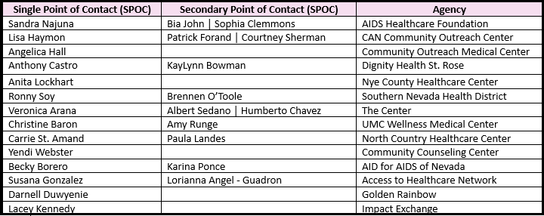
3
WELCOME AND INTRODUCTIONS
Clinical Quality Management Committee
SINGLE & SECONDARY POINTs OF CONTACT (SPoCs)

Slide 4

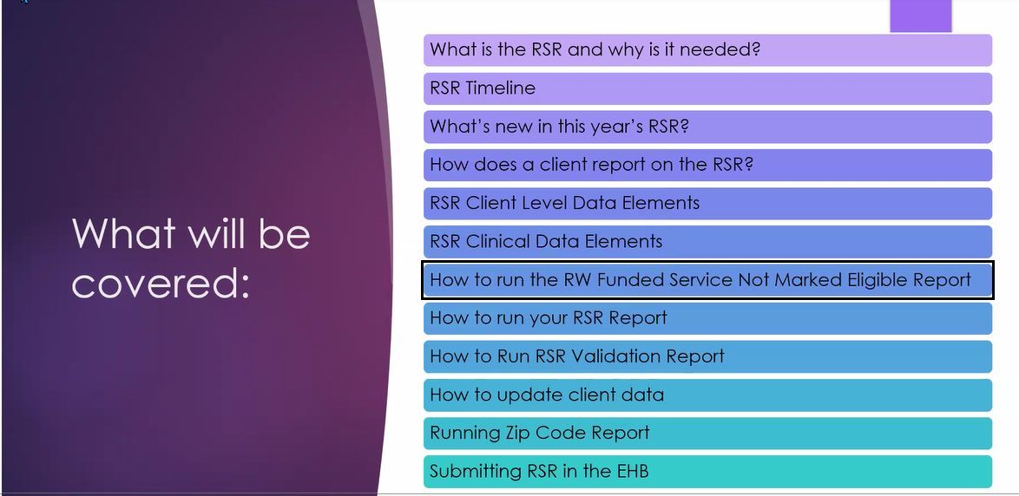
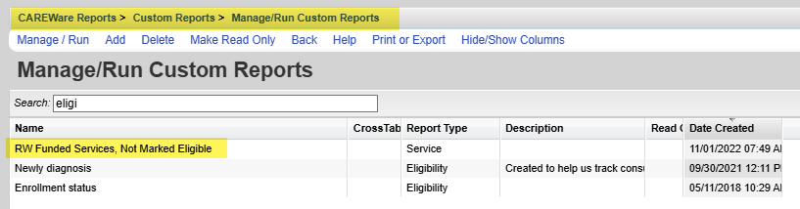
The intent of this report is to show you if clients who received a funded services were marked “not eligible” at the time. The reason why we want to know who these clients are is because if there is a service they received, we want to make sure it is reported on the RSR.
This custom report was created for you to regularly inspect and verify the accuracy of how your clients are being reported.
Once you open your report, you will see a service provider information of clients they served and the service category and subservice in question.
Ryan White Funded Services, Not Marked Eligible Report

Slide 5

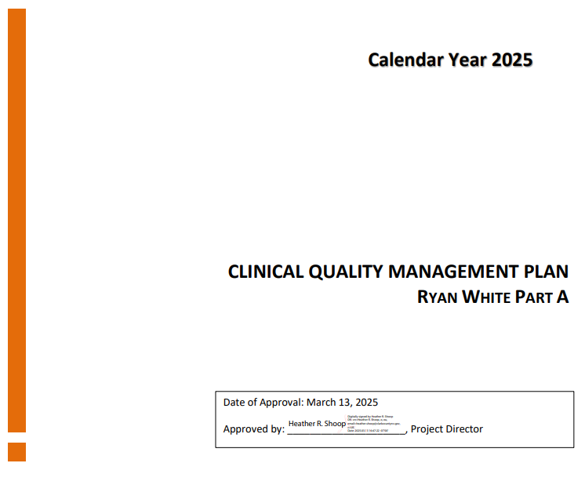
Providers’ Roles & Responsibilities
Actively engaged in capacity building training and retraining in QI PDSA methodology.
Actively participates in Lab Data Days to integrate data insights into their workflows and enhance data-driven decision-making.
Conducts PDSA cycles, presents QIP proposals and outcomes.
Acts as subject matter experts in monthly CQM Advisory Committee meetings.
Leads QI and data-driven conversations with their internal CQM team and is engaged in planning and evaluation.
Routinely reviews performance measures and is accountable for entering current and consistent data for collection and reporting purposes.
Conducts consumer satisfaction surveys to measure the impact of the RWPA Program.
Meets contract deliverables.

Slide 6
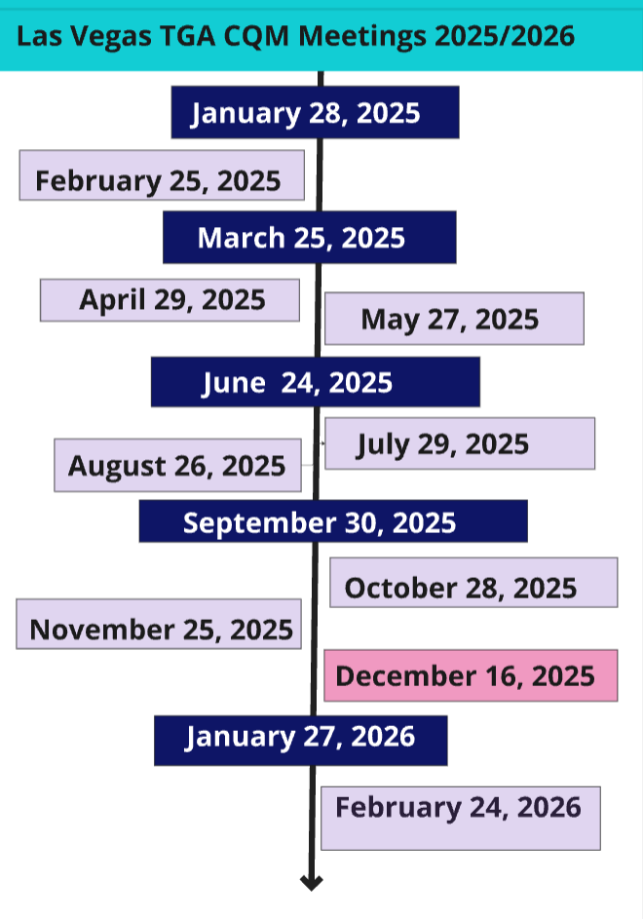
Upcoming CQM Meetings
Calendar invitations were sent in January: Providers are encouraged to plan and consider any coverage needs.
Ongoing meetings: These sessions will ensure everyone stays informed throughout the year, reducing confusion about upcoming tasks and expectations.
Forward invitations: Please share these calendar invites with any new colleagues joining our committee meeting.

Slide 7

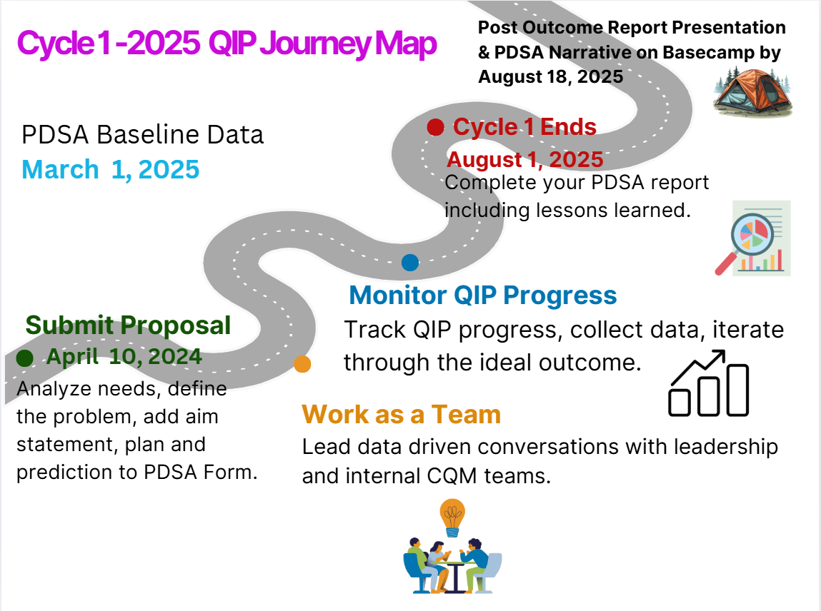

Slide 8
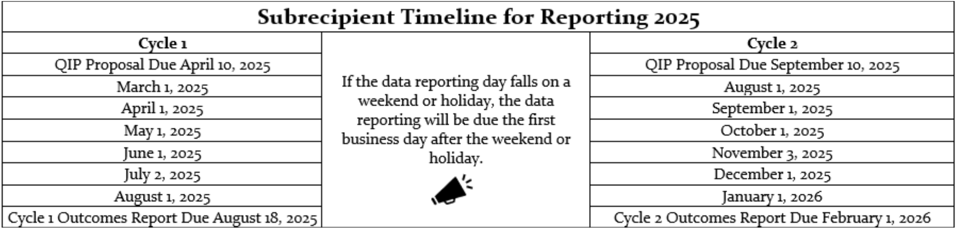
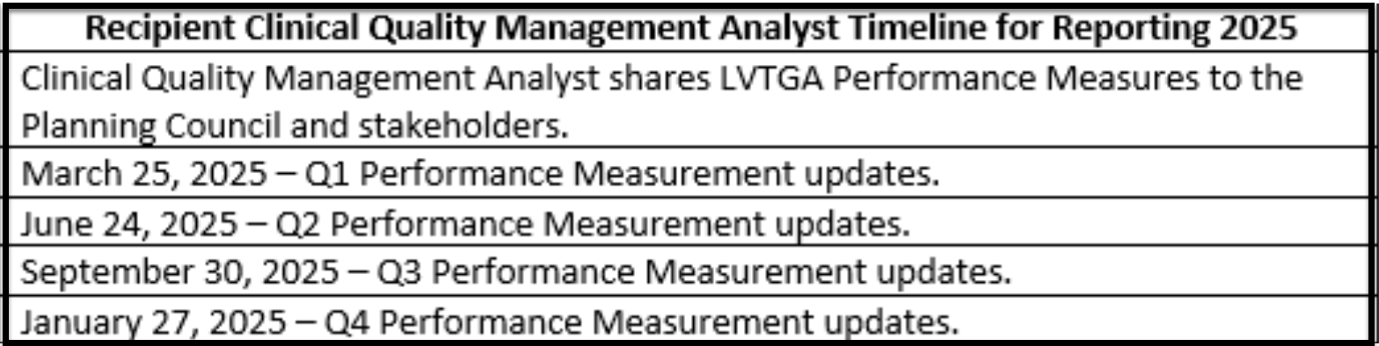

Slide 9



CQM Learning Portal Resources
Under 3 minutes
Accessible on the LVTGA website
Correspond to PDSA Form & CQM QIP Projects
Capacity Building

Slide 10
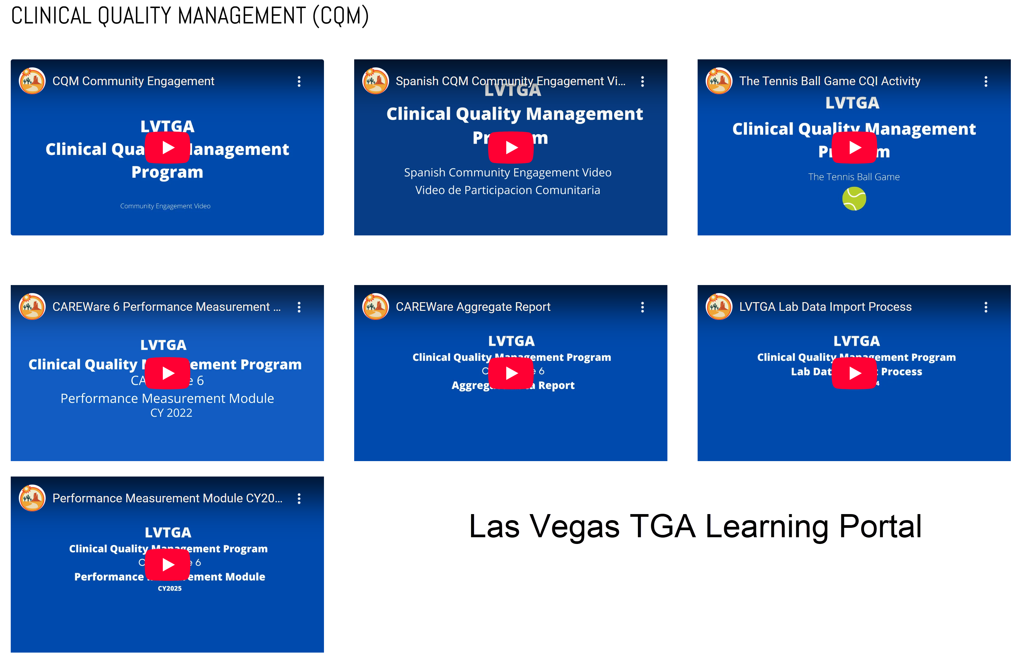
CQM Learning Portal Resources

Slide 11

Reminders:
Cycle 1 QIP PDSA Proposals are due April 10, 2025.
Lab Data Day | Q1 – April 23, 2025
Next CQM Meeting - April 29, 2025

